Slide 1
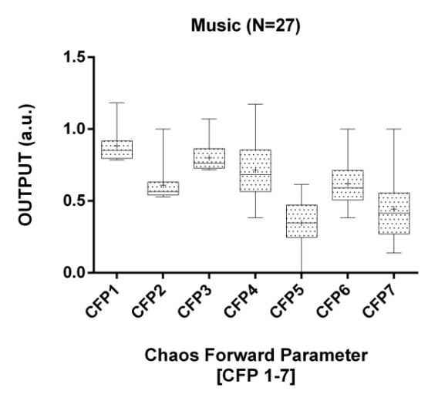
Figure 2: The box plot illustrates the mean values and standard deviation of CFP for the ECGs RR intervals of subjects with musical auditory
stimulation. Mean values are indicated by the (+) symbol. All 27 subjects have data of length 500 RR intervals.

