Slide 1
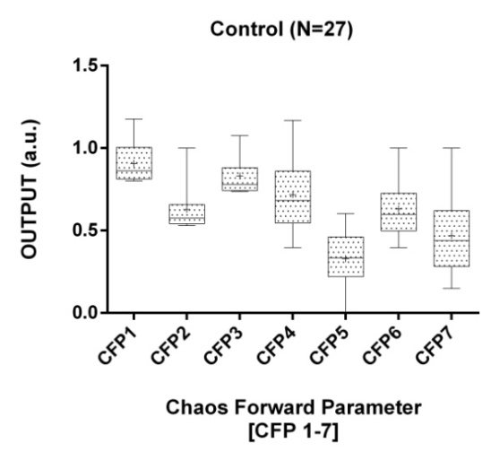
Figure 1: The boxplot illustrates the mean values and standard deviation of CFP for control subjects ECG RR intervals. The mean value is
indicated by the (+) symbol in the boxplot. There are 500 RR intervals across 27 subjects.

